Slide 1
Biological Databases
Dr. Friederike Ehrhart
Department of Bioinformatics – BiGCaT
Maastricht University

Slide 2

Biological data and its size
3,100,000,000 bp DNA per individual
22,000 (protein coding) genes
120,000 transcripts
100,000 proteins
40,000 metabolites
Notes:
About 16 000 metabolites – rest is from food, drugs, cosmetics, pollution, coffee…
Coffee has about 1000 compounds
>1500 drugs and >22,000 food constituents or food metabolites

Slide 3
What is a database?
Systematic collection of data
Has a database management system to access, share, manage, update and use data
Prevents conflicting and duplication of data
…
Tools and support for visualization and analysis

Slide 4
Types of biological databases
Primary – raw data, directly derived from experimental data, since about 1970
Nucleotide sequence (GenBank, DDBJ, EMBL)
Protein sequence (SwissProt, TrEMBL -> UniProt, PDB)
Secondary – derived and modified from primary data for specific use – first tools and visualization support (BLAST, Sequence alignment about 1980)
Protein structure (PDB, SwissProt, UniProt)
Genetic variation, domain and motif databases (RefSeq, Ensembl, dbSNP)
Notes:
DDBJ – Japanese
GenBank – NCBI
EMBL – European, by EBI 1980
-
PDB – 50 years in 2021

Slide 5

Derived databases
Structural database (SCOP, CATH) – protein 3 D structures
Gene expression database (GEO, ArrayExpress) – gene expression data, first microarrays in the 1990ies – big expansion of omics data after 2000
Pathways database (KEGG, PathDB, WikiPathways)
Other, specialized databases
Species (Wormbase, HIV sequence, Flybase)
Bio imaging – microscopic images, MRI
Phenotyping (Decipher, HPO)
Gene-disease, variant-disease association (ClinVar, OMIM, DisGeNET)
miRNA-target (MirTarBase, mirBase)
Protein-protein interaction (IntAct, STRING)
Protein-chemical compound interaction (ChEMBL, DrugBank, CTD)
….
> 2064 biol. databases

Slide 6
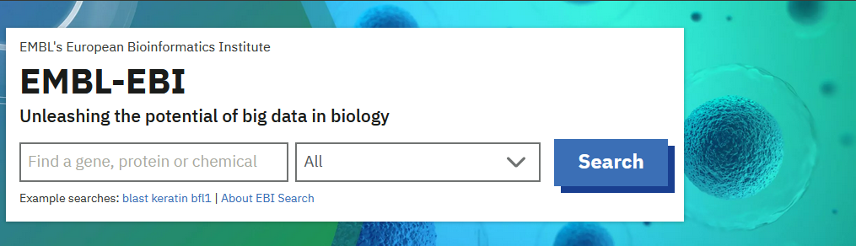

The databases of databases
https://www.ebi.ac.uk/services/data-resources-and-tools
https://fairsharing.org

Slide 7
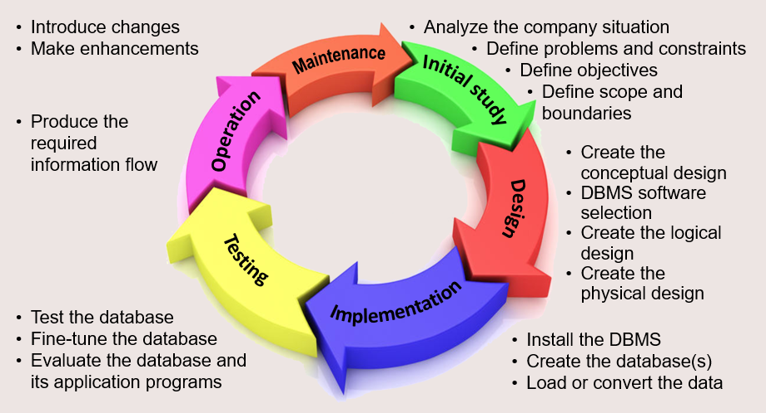

The life cycle of databases
Funded project starts
Funded project ends
Fast or slow death due to lack of maintenance
Database Management System (DBMS)
Coronel and Morris (2019)
Notes:
Database with open licens –asleep till waked up again

Slide 8
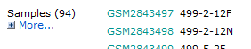
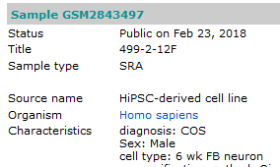

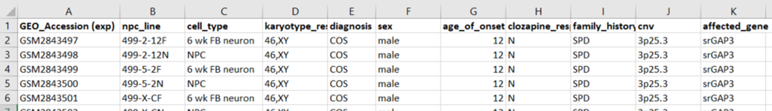
How is data organised?
Identifier
unique per database!
Field
Record

Slide 9
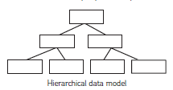
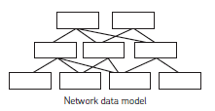
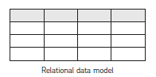


Database models
Database… annotation system…

Slide 10
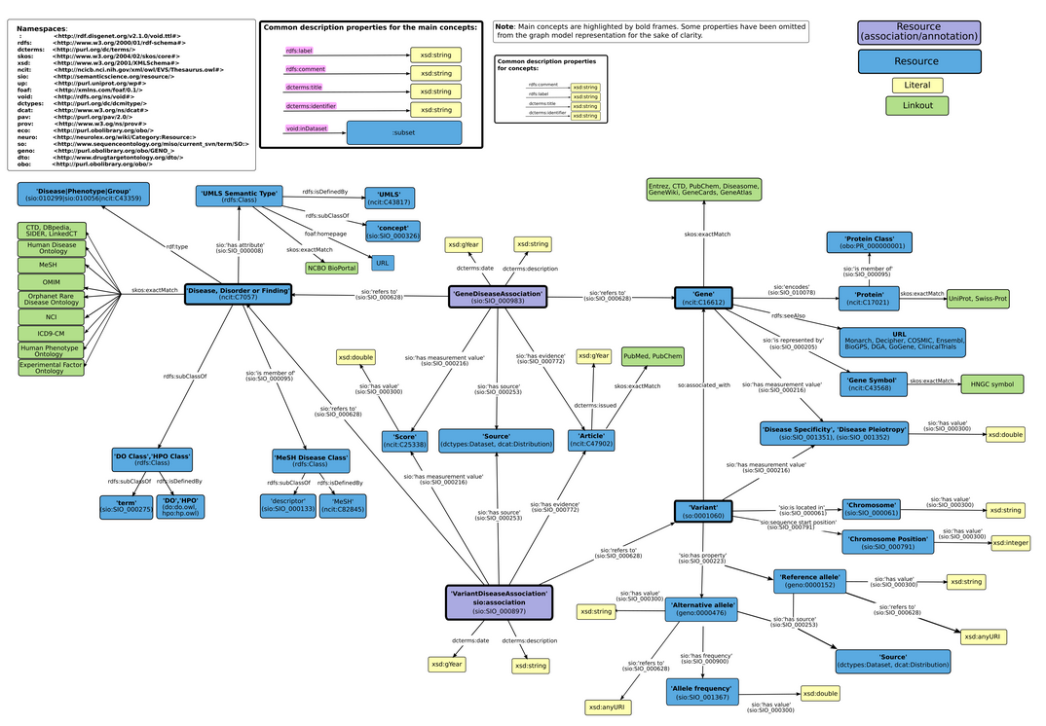
Network model
Organised in network structure with clearly defined relations between the items:
exactMatch
subClassOf
isMemberOf
hasValue or has_measurement_value
https://www.disgenet.org/static/disgenet_ap1/images/rdf/disgenet_rdf_schema_v7.png

Slide 11

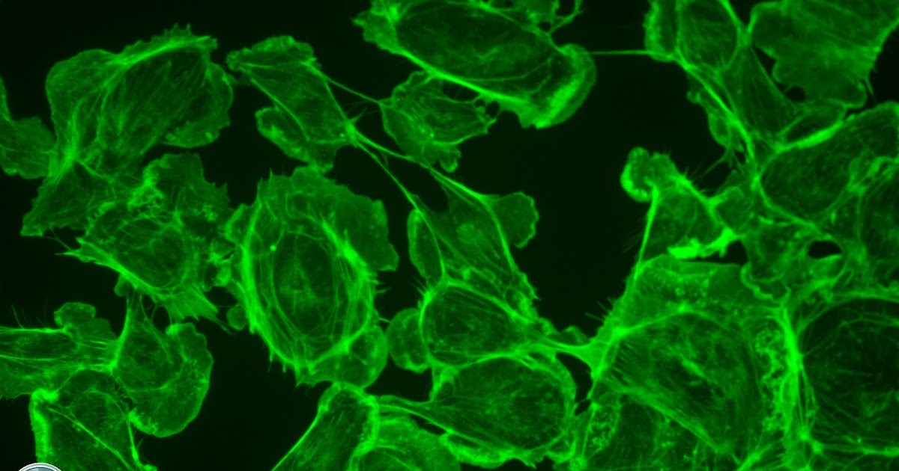
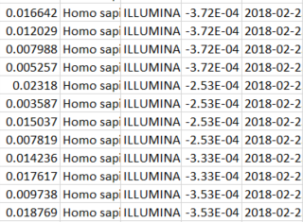
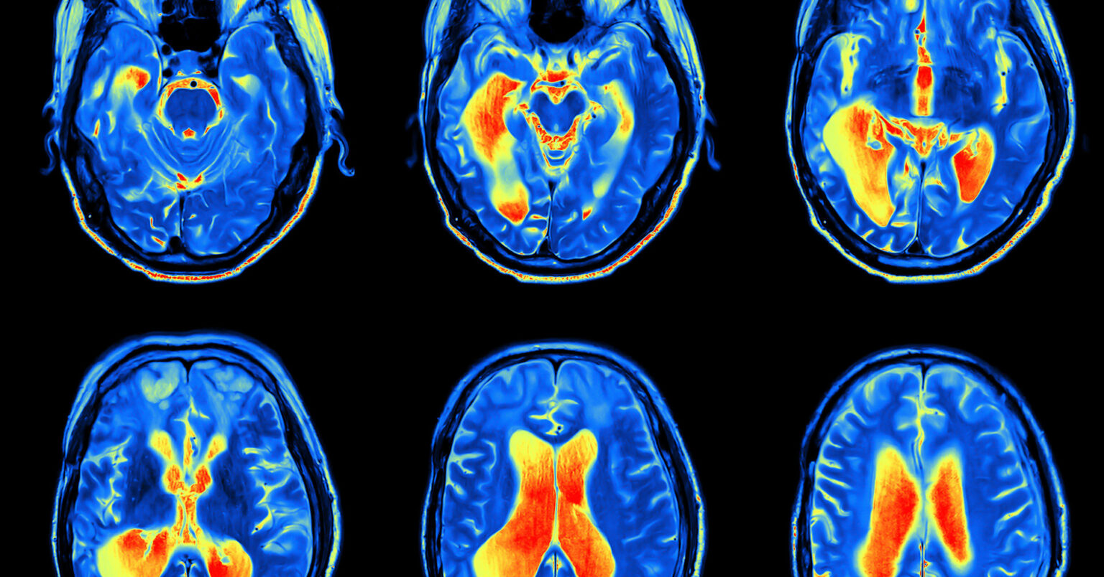
Data and data annotation

Slide 12
Data and data annotation
Data annotation is a service/action that makes data accessible for human and machine (re-)use
Using natural language can cause confusion
Especially with use of abbreviations, lab slang, different languages

Slide 13
Natural language
Sex vs. gender?
Patient sex
M/F
0/1
Male/female
Ml/Wbl
M/W
Мушки / Женско
M/Z
1/0
1/2
Age at intake?
Age at diagnosis?
Age at first symptoms
Age at a certain measurement?
Age
10 y/years/j
14 m/months
30.03.1976

Slide 14
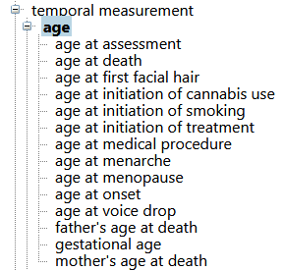
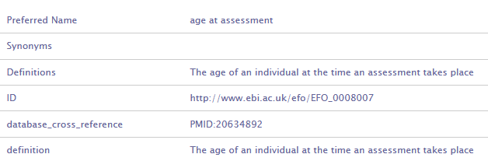

Structured language and ontologies
EFO
Experimental Factor Ontology
measurement
https://bioportal.bioontology.org/

Slide 15
The Gene Ontology – yes, all 3 of them
Molecular function = elemental activity/task
The task performed by a gene product – e.g. carbohydrate binding or ATPase activity
Biological Process = biological goal or objective
Broad biological goals such as mitosis or purine metabolism, but also more detailed ones such as synapsis re-uptake
Cellular Component = location or comples
Subcellular structures, locations and macromolecular complexes e.g. nucleus, telomere, RNA polymerase 2

Slide 16
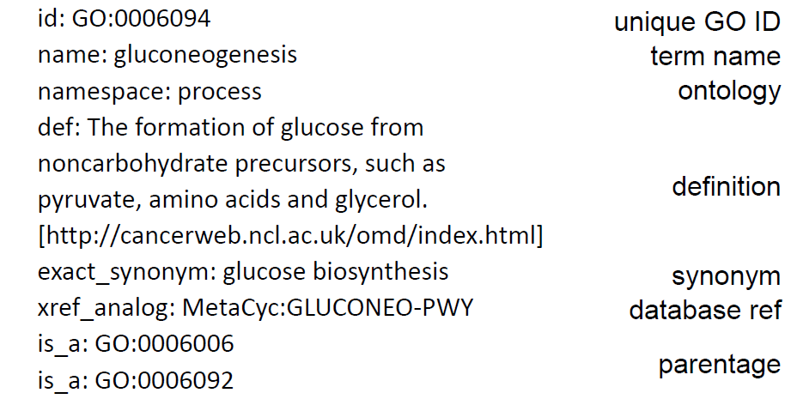
Anatomy of a GO term
(main pathway of carbohydrate metabolism)
(glucose metabolic process)

Slide 17
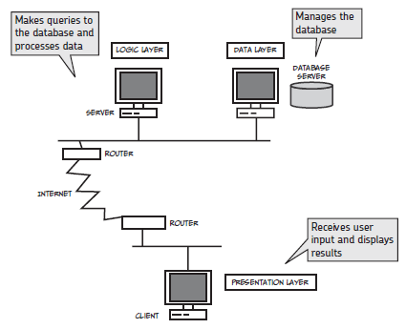
How to access databases
Querying language
SQL (relational)
SPARQL (network)
Web-interface
Graphical user interface (GUI)
Programmatic access
Download server
API
SPARQL endpoint
Software packages that use API or SPARQL endpoints

Slide 18
Concrete examples in the hands on
Genome centered databases:
Ensembl
NCBI Gene
Protein database: Uniprot
Gene-disease association database: DisGeNET
Other databases we will (or have already) visited in this course:
GEO (gene expression database)
WikiPathways (pathway database)
STRING (protein-protein interaction database)

Slide 19
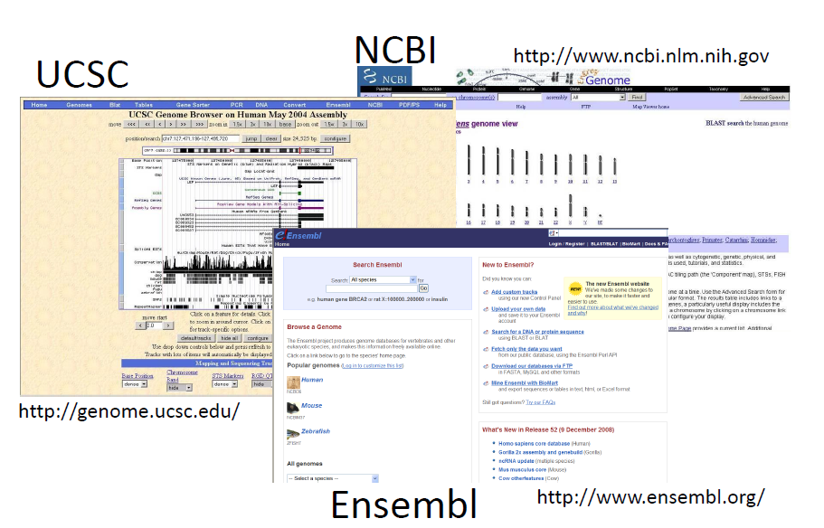
Genome centered databases

Slide 20
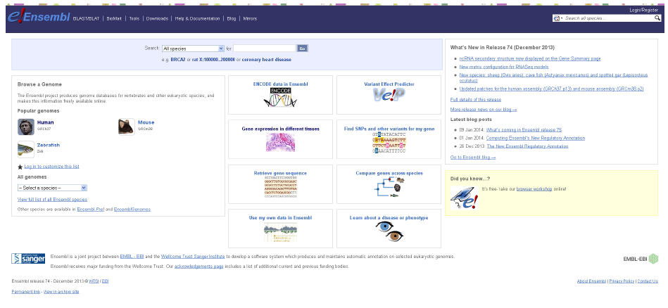
Ensembl

Slide 21
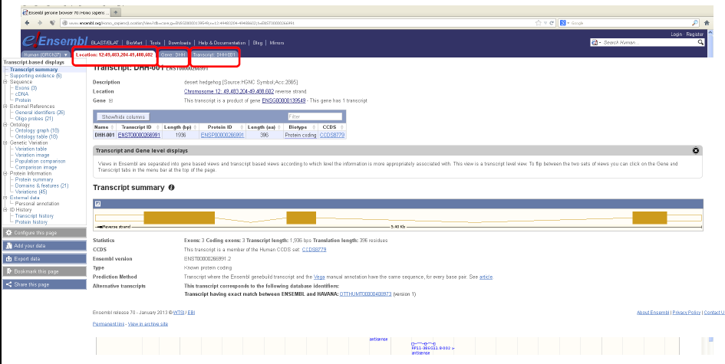
Example: DHH
Location
Gene
Transcript
Even more information
Intron
Exon
Notes:
Desert hedgehog
Gender phenotype development

Slide 22
Where does all this information come from?
Submissions (e.g. Sequences)
Literature
Curators and contributors
Automated generation by computer tools
High-throughput lab screenings
Individual contributions and large scale contributions

Slide 23
Example: DHH
Identifiers
Learn more in the practical!
Notes:
identifiers

Slide 24
Identifiers and identifier mapping
Dr. Friederike Ehrhart
(BridgeDb slides courtesy of Dr. Tooba Abbassi-Daloi)

Slide 25
One unique identifier for each database
RefSeq:
Chromosome: NC_
mRNA: NM_
Protein: NP_
Genbank:
Many types of IDs
NCBI gene ID:
1
23456
HGNC:
Symbol
ID - 123455
OMIM ID:
#60123
Pubmed ID:
62145
dbSNP:
rs1234567
Ensembl:
ENSG001234567
ENSMUS0123456
UniProt:
PQ12345
A012345667

Slide 26
Ensembl identifiers
ENSG### Ensembl Gene ID
ENST### Ensembl Transcript ID
ENSP### Ensembl Peptide ID
ENSE### Ensembl Exon ID
For other species than human a suffix is added:
MUS (Mus musculus) for mouse: ENSMUSG###
DAR (Danio rerio) for zebrafish: ENSDARG###, etc.

Slide 27
OMIM
* = gene.
# = descriptive entry, usually of a phenotype, and does not represent a unique locus
+ = description of a gene of known sequence and a phenotype
% = confirmed mendelian phenotype or phenotypic locus for which the underlying molecular basis is not known
No symbol = description of a phenotype for which the mendelian basis, although suspected, has not been clearly established or that the separateness of this phenotype from that in another entry is unclear
^ = the entry no longer exists because it was removed from the database or moved to another entry as indicated
1- (100000- ) 2- (200000- ) Autosomal loci or phenotypes (entries created before May 15, 1994)
3- (300000- ) X-linked loci or phenotypes
4- (400000- ) Y-linked loci or phenotypes
5- (500000- ) Mitochondrial loci or phenotypes
6- (600000- ) Autosomal loci or phenotypes (entries created after May 15, 1994)

Slide 28
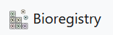
Registry of identifiers: MIRIAM
Online resource to catalogue data types, their URI and corresponding resource
Pattern for local unique identifiers – e.g. WP\d{1,5}
CURIES (compact URIs) – e.g. WikiPathways:WP1234

Slide 29
Mapping
Content mapping: where we are mapping the actual entities by using techniques such as BLAST in biological sequences or comparing InChI identifiers for chemical compounds.
Ontology mapping: this can either be:
As a direct 1-to-1 mapping between equivalent terms in different ontologies.
As a complex m-to-m mapping between terms in different ontologies taking into account their hierarchical structure, see {footcite}.wang_concept_2010.
Identifier mapping: this can either be:
Mapping between differently formed identifiers that resolve to the same entity. (e.g. the same gene with different identifiers under HGNC and Ensembl).
Mapping between entities that are related enough to be usefully connected (e.g. linking information on proteins, genes, RNA and reporter sequences for these).
Mapping between databases containing different information about the same entity (e.g. links between the protein sequence database UniProt and the protein 3D structure database PDB)
https://faircookbook.elixir-europe.org/content/recipes/interoperability/identifier-mapping.html

Slide 30
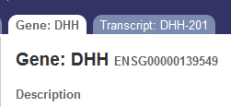
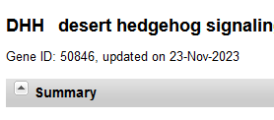
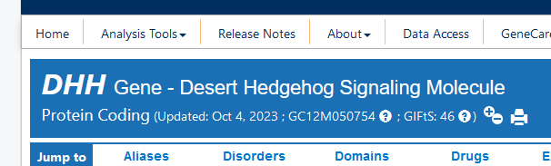
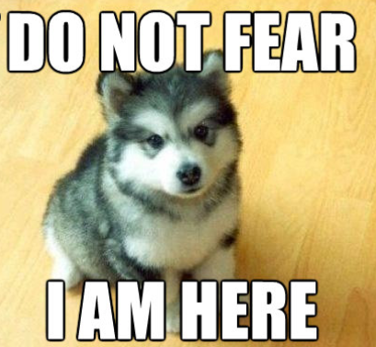
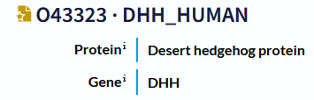
What if there is more than 1 database…?
Identifier mapping
=
=
Is protein product of
Identifier mapping tools and
mapping databases
BioMart (Ensembl)
bridgeDb
g:Convert
UniProt Retrieve/ID mapping
“Entity” mapping

Slide 31

BioMart
Data mining tool provided by Ensembl database
Allows data extraction via webtool
BiomaRt = R package
REST API for programmatic data extraction
Notes:
NOT
Focus on transcriptomics data

Slide 32

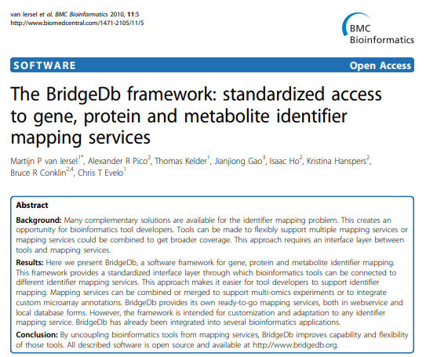
BridgeDb
Identifier mappings between various biological databases
Java library
A webservice
Integrations into other platforms
Notes:
BridgeDb introduced in 2010 and is a framework to map identifiers between various biological databases and related resources. BridgeDb includes a Java library for software integration, a REST-API for programmatic access

Slide 33
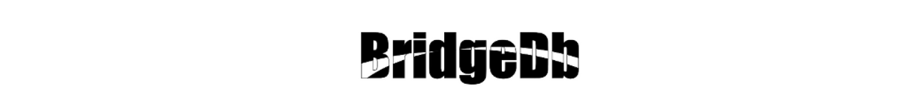
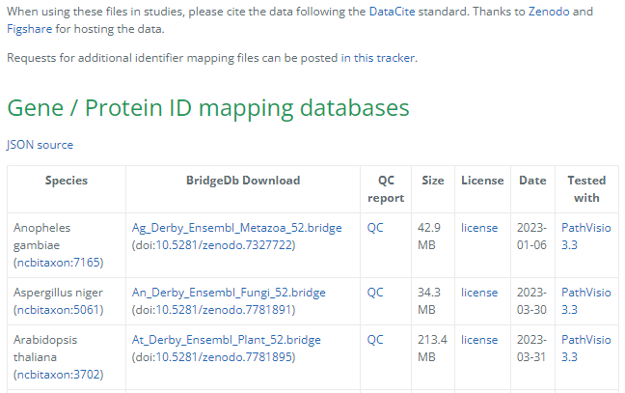
Sources of identifier mappings
Genes and proteins
Ensembl, NCBI, HGNC, UniProt, …
Metabolites
HMDB, ChEBI, LIPID MAPS, PubChem, Wikidata, …
Publications
DOI, PubMed, Europe PMC (from Wikidata)
Interactions
Rhea, Complex Portal
Interoperability via identifier.org support
Notes:
The mappings are provided for genes, proteins, metabolites, metabolic reactions, diseases, complexes and publications.
BridgeDb also improves the Interoperability via identifier.org support

Slide 34
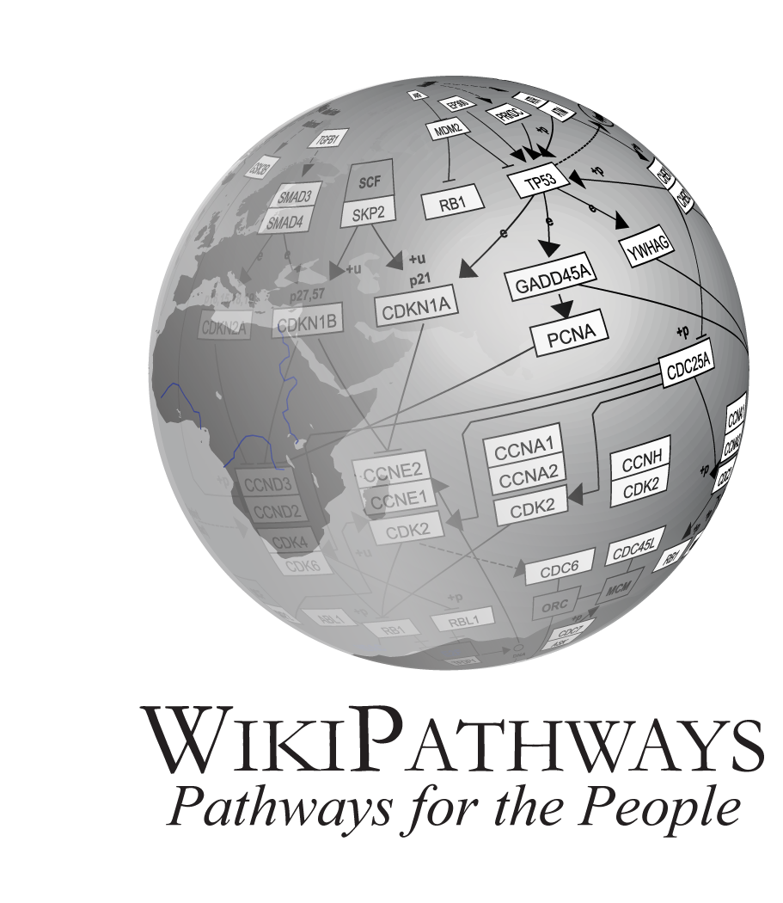
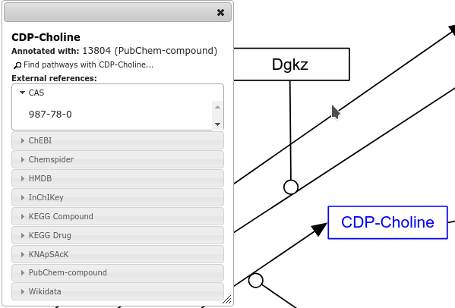
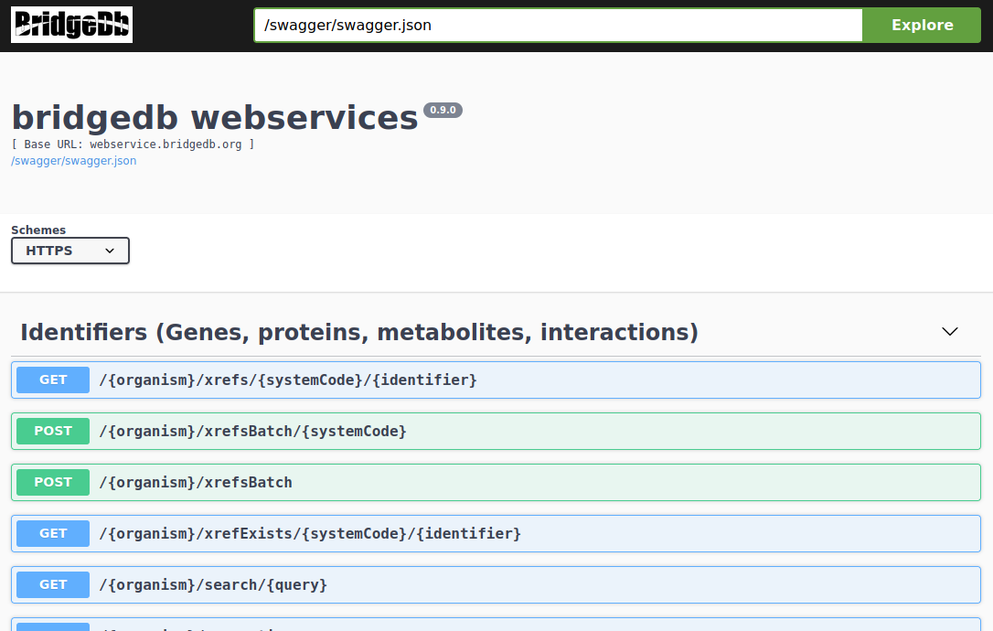
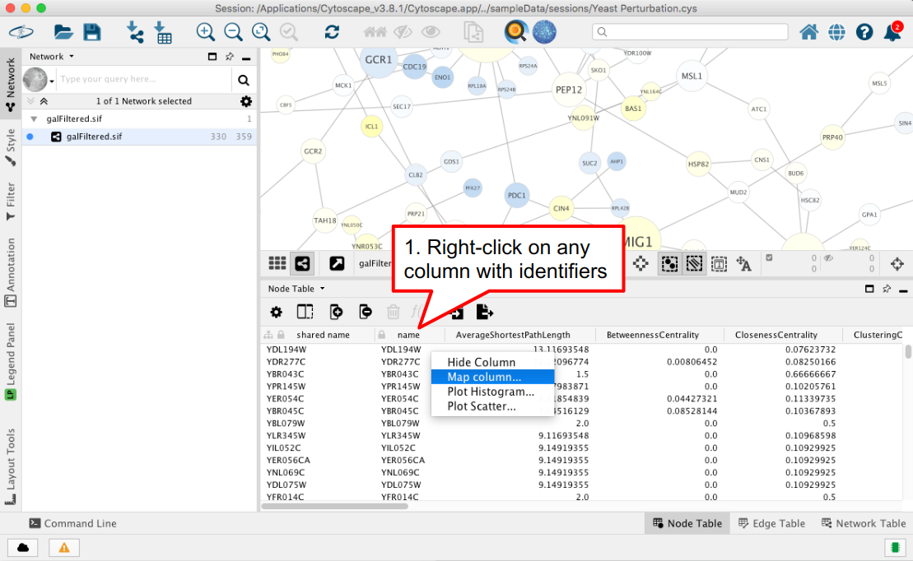
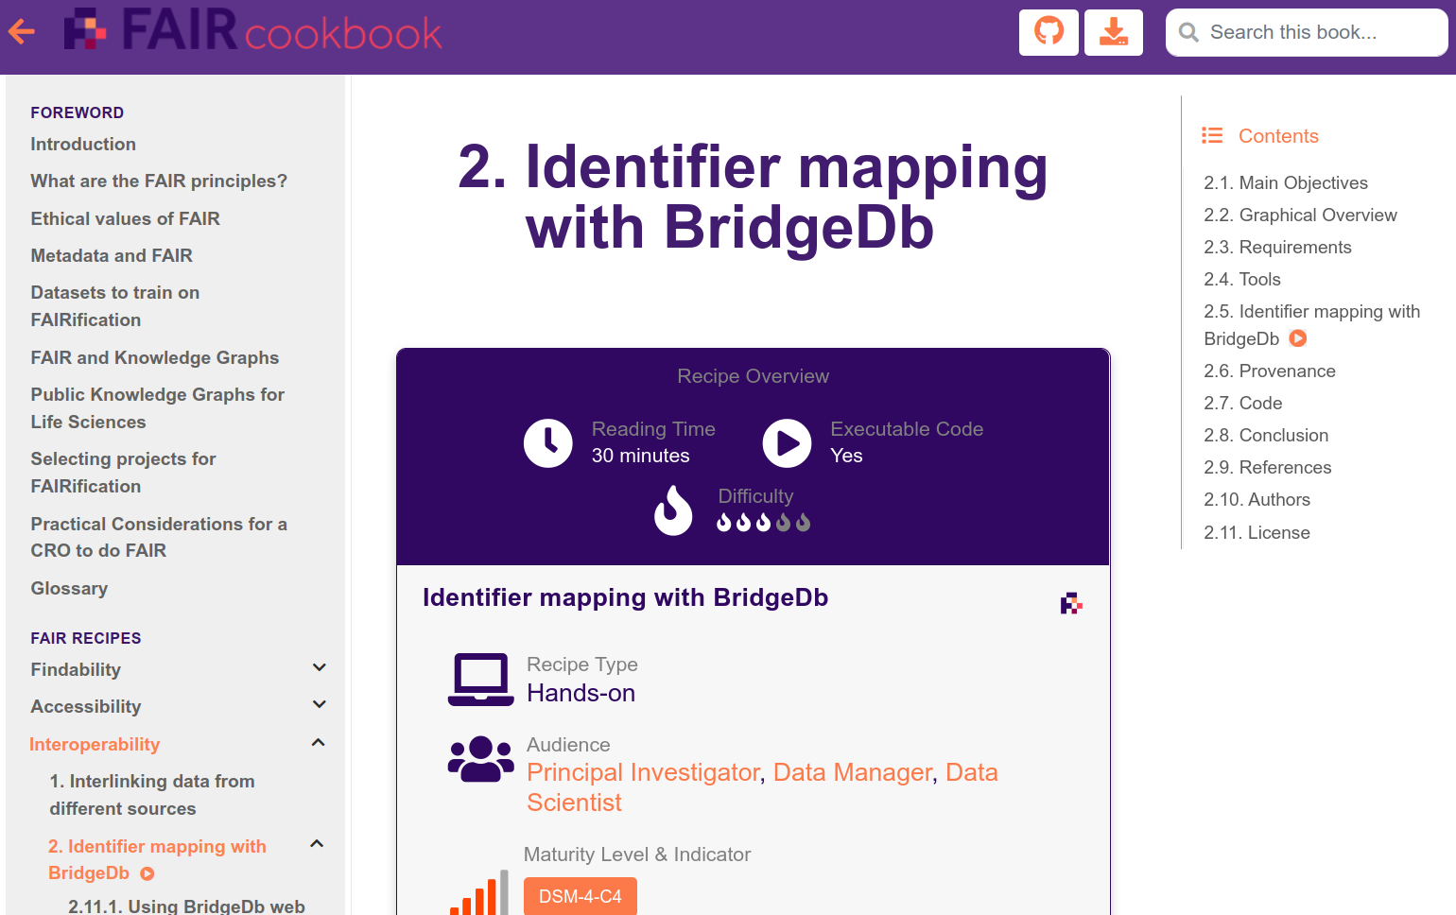
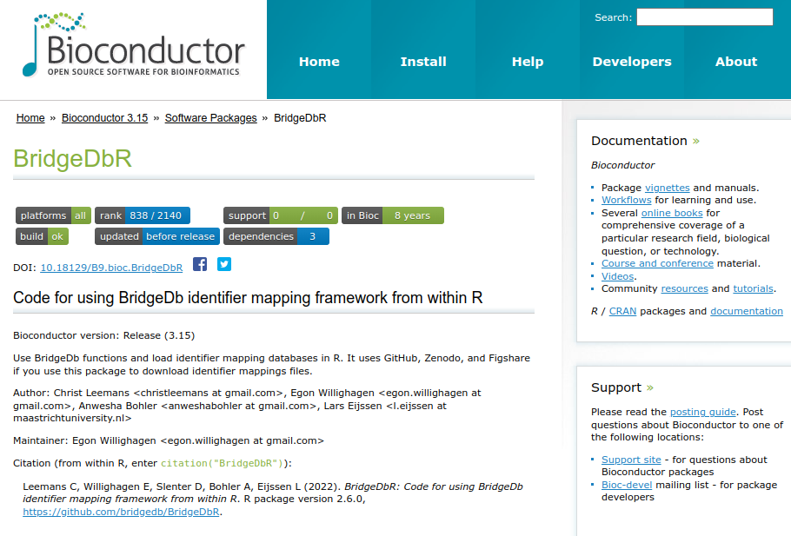
BridgeDb can be used in multiple platforms
Cytoscape
Python
R (stats)

Slide 35
Problems with ID mapping
ID mapping tools:
Coverage of species
Coverage of identifier types
Access speed
Frequency of updates
Database sources:
Frequency of updates
Primary and secondary identifiers
Deprecated identifiers

Slide 36


ID mapping via webtool and R script
-> more in the hands-on!

